Slide 1
Counters
Siemens
© 2014 John Sefcovic.

Slide 2
Counters
A Counter changes the state of an output based on the Count Value.
A Counter can increment a count.
A Counter can decrement a count.
There are three Counter instructions.
Counter Up (CTU)
Counter Down (CTD)
Counter Up/Down (CTUD)

Slide 3
Counters
The Counter changes the count on a False to True rung transition.
The Counter uses a PRESET VALUE to determine the number of count events.
The Counter uses an COUNTER VALUE to track the count events.
The Counter uses an OUTPUT BIT to indicate when the PRESET VALUE is greater than or equal or less than or equals to the COUNTER VALUE.
The Counter OUTPUT BIT state is used to control an output in the process or application.

Slide 4
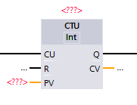
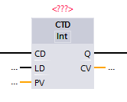
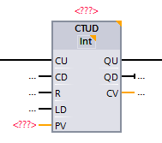
Block Counters

Slide 5
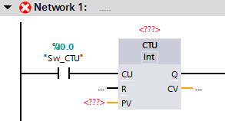
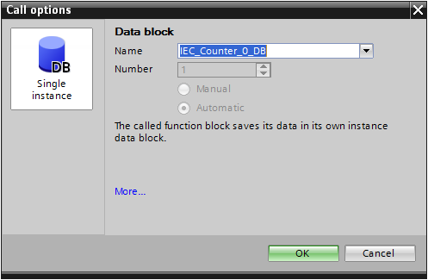
Counter IEC Data Block
When the Counter Block instruction is added to the Network rung…
… the IEC Data Block dialog opens automatically.

Slide 6
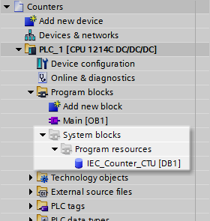
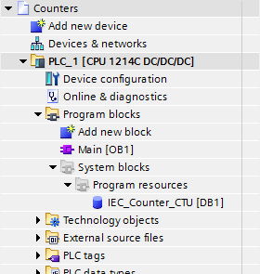
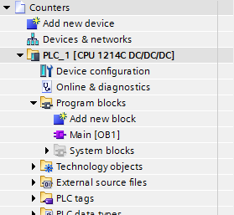
Counter IEC Data Block
The IEC_Counter_Data_Block is added to the Project Tree…
… under System blocks as a Program resource.

Slide 7
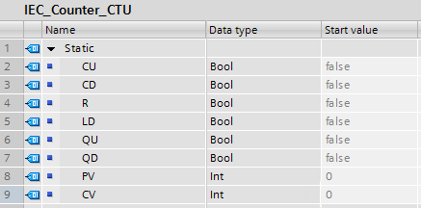
Counter IEC Data Block
The table for the IEC_Counter_Data_Block stores the Preset Value, Counter Value and the In, Output, and Reset/Load Bits.

Slide 8
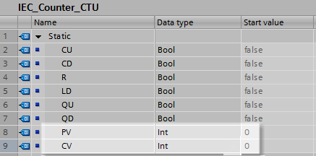
Counter IEC Data Block
The table for the IEC_Counter_Data_Block stores the Preset Value, Counter Value and the In, Output, and Reset/Load Bits.
The Preset Value (PV) holds the value of events to count.
The Counter Value (CV) holds the current number of the events counted.

Slide 9
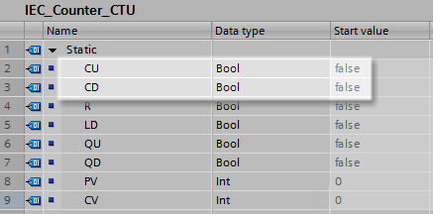
Counter IEC Data Block
The table for the IEC_Counter_Data_Block stores the Preset Value, Counter Value and the In, Output, and Reset/Load Bits.
The Input Bits (CU or CD) reflects the Result of Logic Operation (RLO) preceding the instruction.
Each counter type, Count Up or Count Down uses the corresponding
In Bit.
CU – Counter Up
CD – Counter Down

Slide 10
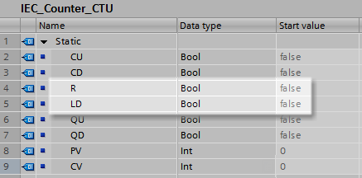
Counter IEC Data Block
The table for the IEC_Counter_Data_Block stores the Preset Value, Counter Value and the In, Output, and Reset/Load Bits.
The Reset or Load Bits (R or LD) reflects the Result of Logic Operation (RLO) preceding the instruction.
Each counter type, Count Up or Count Down uses the corresponding
Load or Reset Bit.
R – Counter Up
LD – Counter Down

Slide 11
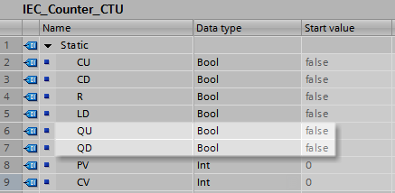
Counter IEC Data Block
The table for the IEC_Counter_Data_Block stores the Preset Value, Counter Value and the In, Output, and Reset/Load Bits.
The Output Bits (QU or QD) holds the current status of the counting operation and will change at the completion of the counting cycle or preceding RLO to the instruction.
Each counter type, Count Up or Count Down uses the corresponding
Output Bit.
QU – Counter Up
QD – Counter Down

Slide 12
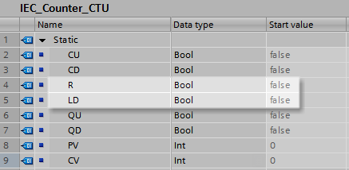
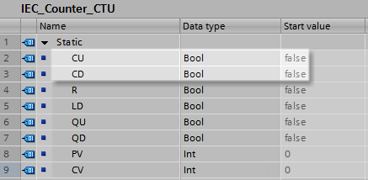
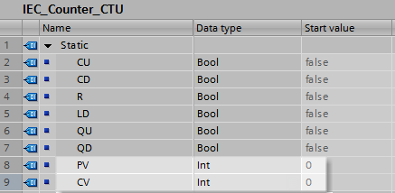
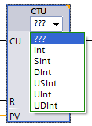
Counter IEC Data Block
The table for the IEC_Counter_Data_Block stores the Preset Value, Counter Value and the In, Output, and Reset/Load Bits.
Preset Value is an Integer Data Types
Counter Value is an Integer Data Types
In Bits are a Boolean Data Type
Output Bits are a Boolean Data Type
Reset and Load Bits are a Boolean Data Type

Slide 13
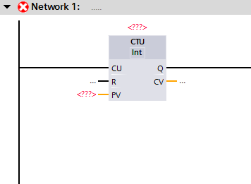
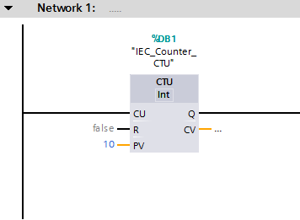
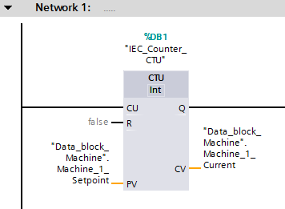
Block Counters Parameters
The added Counter will used the IEC_Data_Block.
A value must be entered for the Preset Value. It may be a Constant value or a Tag.
The Preset Value and Counter Value may both be assigned Tags.
The Counter Value is optional, but must be a Tag.

Slide 14
Counter Up
COUNTER UP (CTU)
The Counter Up (CTU) is an instruction that will turn on a controlled output when the Count Value (CV) is greater than or equal to the Preset Value (PV).
The equal values will result in the Output Bit (QU) being set. The Output Bit is used to control other logic.
When the rung transitions from false to true, the counter increments.
The Reset (R) returns the Count Value to zero.

Slide 15
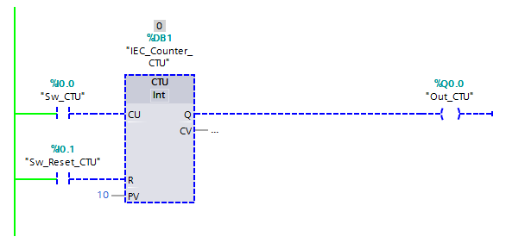
Counter Up
When the rung is FALSE, the Counter Value for the counter does not increment.
The Output Bit is reset, Off.

Slide 16
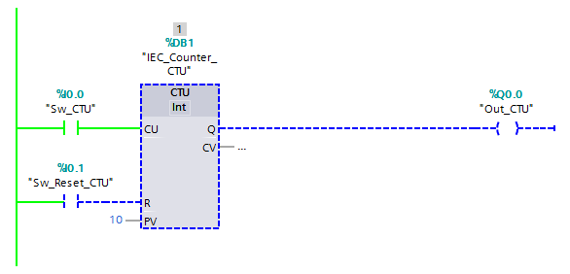
Counter Up
When the rung transitions to TRUE, the Counter Value for the counter does increment.
The Output Bit is reset, Off.

Slide 17
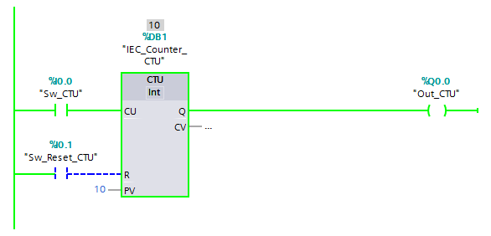
Counter Up
When Counter Value is EQUAL TO (or GREATER THAN) the Preset Count, the Output is set, turned ON.

Slide 18
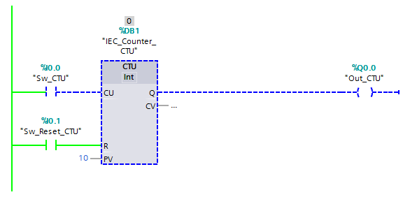
Counter Up
When the Reset (R) is TRUE, the Counter Value is returned to zero and the Output Bit resets.
Note: if at any point in the counting cycle, the Reset returns to the counter to the initial conditions.

Slide 19
Counter Down
COUNTER DOWN (CTD)
The Counter Down (CTD) is an instruction that will turn on a controlled output when the Count Value (CV) is equal to or less than zero.
The equal to or less than zero value will result in the Output Bit (QD) being set. The Output Bit is used to control other logic.
When the rung transitions from false to true, the counter decrements.
The Load (LD) returns the Count Value to the preset Value.

Slide 20
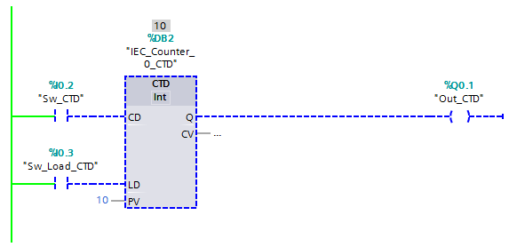
Counter Down
Notice the CV value is the same as the PV value.
When the rung is FALSE, the Counter Value for the counter does not decrement.
The Output Bit is reset, Off.

Slide 21
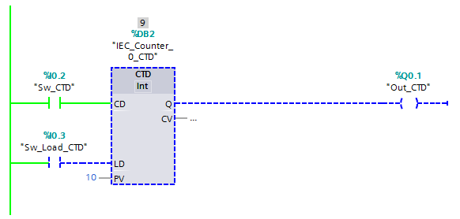
Counter Down
When the rung transitions to TRUE, the Counter Value for the counter does decrement.
The Output Bit is reset, Off.

Slide 22
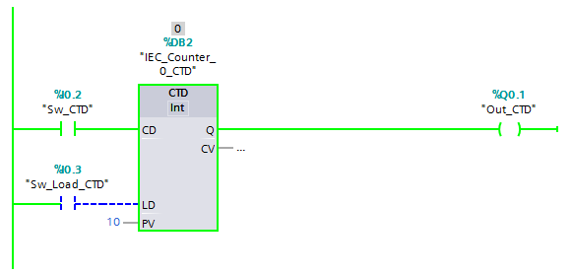
Counter Down
When Counter Value is EQUAL TO or LESS THAN zero, the Output is set, turned ON.

Slide 23
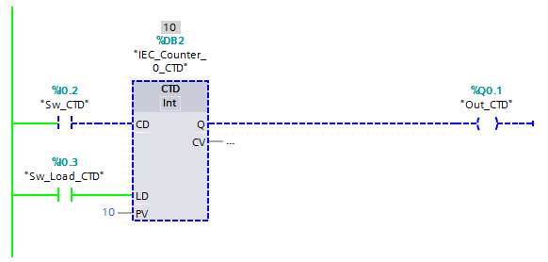
Counter Down
When the Load (LD) is TRUE, the Counter Value is returned to the preset value and the Output Bit resets.
Note: if at any point in the counting cycle, the Load returns to the counter to the initial conditions.

Slide 24
Count Up/Down
COUNTER UP/DOWN (CTUD)
The Counter Up/Down (CTUD) is an instruction that will turn on a controlled output (QU) when the Counter Value (CV) is greater than or equal to the Preset Value (PV).
A Counter Value (CV) less than or equal to the Preset Value (PV) will turn on a controlled output (QD).
When the rung transitions from false to true, the counter increments or decrements, depending on the use of the Count Up (CU) or Count Down (CD).

Slide 25
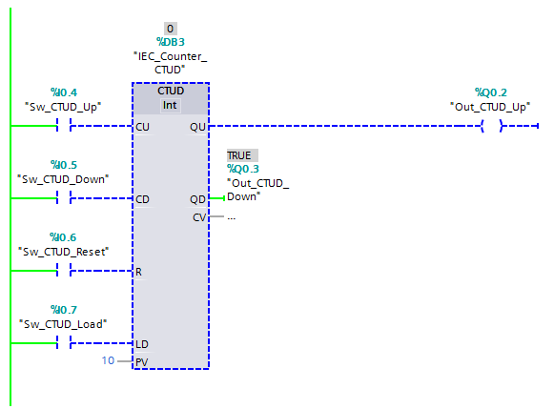
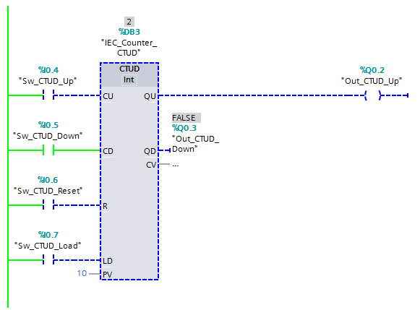

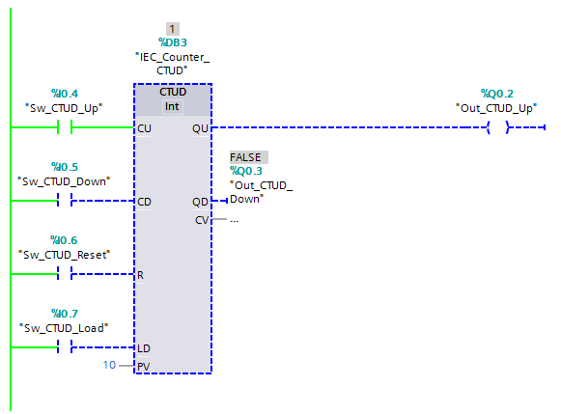
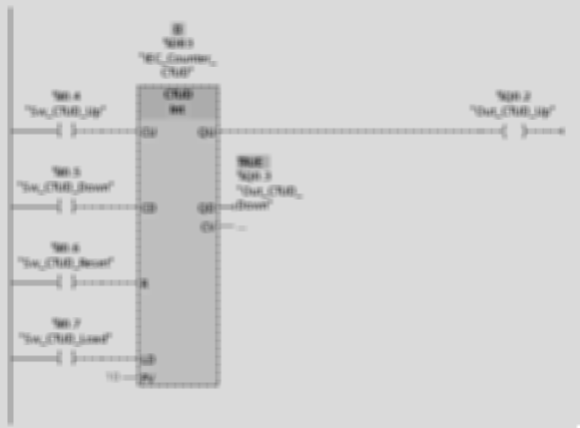
Count Up/Down
While the CU In transitions, the count increments. The count increments to 3.
When the Count Up (CU) In goes TRUE, the count increments.
When the Count Down (CD) In goes TRUE, the count decrements.

Slide 26

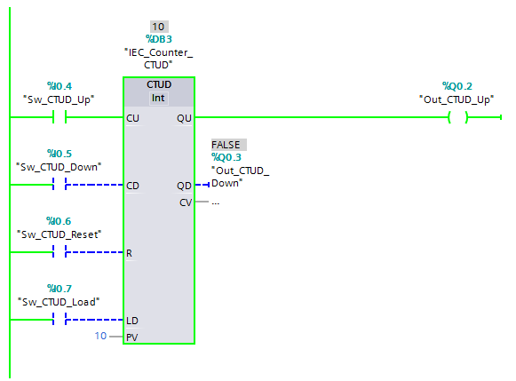
Count Up/Down
With the Counter Value (CV) greater than or equal to the Preset Value (PV), the Output Up (QU) is TRUE.
When the CU In goes TRUE, the count increments.
The Counter Value (CV) has incremented to 9.

Slide 27
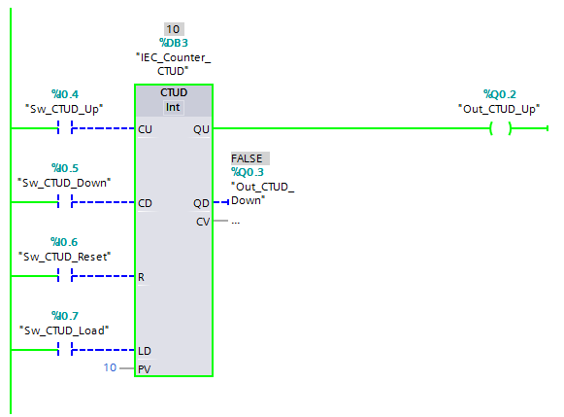

Count Up/Down
When the CD In goes TRUE, the count decrements.

Slide 28

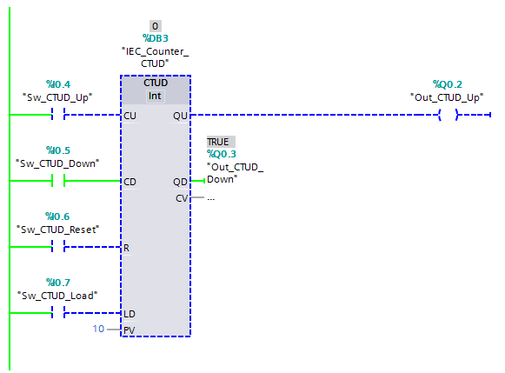
Count Up/Down
With the Counter Value (CV) less than or equal to zero, the Output Down (QD) is TRUE.
The Counter Value (CV) has decremented to 1.
When the CD In goes TRUE, the count decrements.

Slide 29
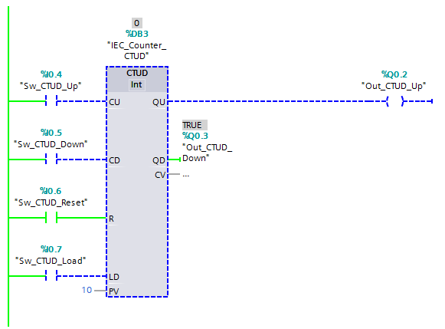
Count Up/Down
The Reset (R) In returns the Counter Value (CV) to zero.

Slide 30
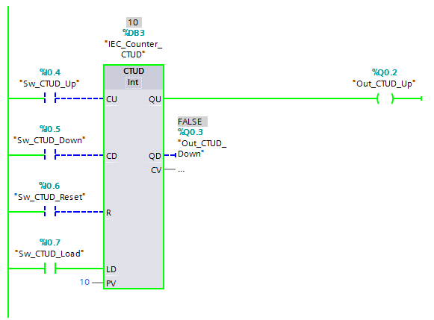
Count Up/Down
The Load (LD) In sets the Counter Value (CV) to the Preset Value (PV).

